Slide 1
Advanced Driver Assistance System (ADAS)
Presentation prepared by:
Subham Patel
M S Keshu
Rachana S K
Moulika K

Slide 2
Introduction
An advanced driver-assistance system (ADAS) includes technologies that assist drivers with the safe operation of a vehicle. Through a human-machine interface, ADAS increases car and road safety. ADAS uses automated technology, such as sensors and cameras, to detect nearby obstacles or driver errors, and respond accordingly. ADAS can enable various levels of autonomous driving.
Adaptive features may automate lighting, provide adaptive cruise control, assist in avoiding collisions, incorporate satellite navigation and traffic warnings, alert drivers to possible obstacles, assist in lane departure and lane centering, provide navigational assistance through smartphones, and provide other features.

Slide 3
Purpose
As most road crashes occur due to human error, ADAS are developed to automate, adapt, and enhance vehicle technology for safety and better driving. ADAS are proven to reduce road fatalities by minimizing human error.
Safety features are designed to avoid crashes and collisions by offering technologies that alert the driver to problems, implementing safeguards, and taking control of the vehicle if necessary.

Slide 4
Scope
To design a comprehensive real-time communication system for an Advanced Driver Assistance System (ADAS) in a vehicle to ensure seamless communication between the different modules to enhance vehicle safety and provide a better driving experience.
The implementation of different IPC mechanisms in C language ensures effective communication and coordination between these modules, contributing to an advanced and integrated driver assistance system.

Slide 5
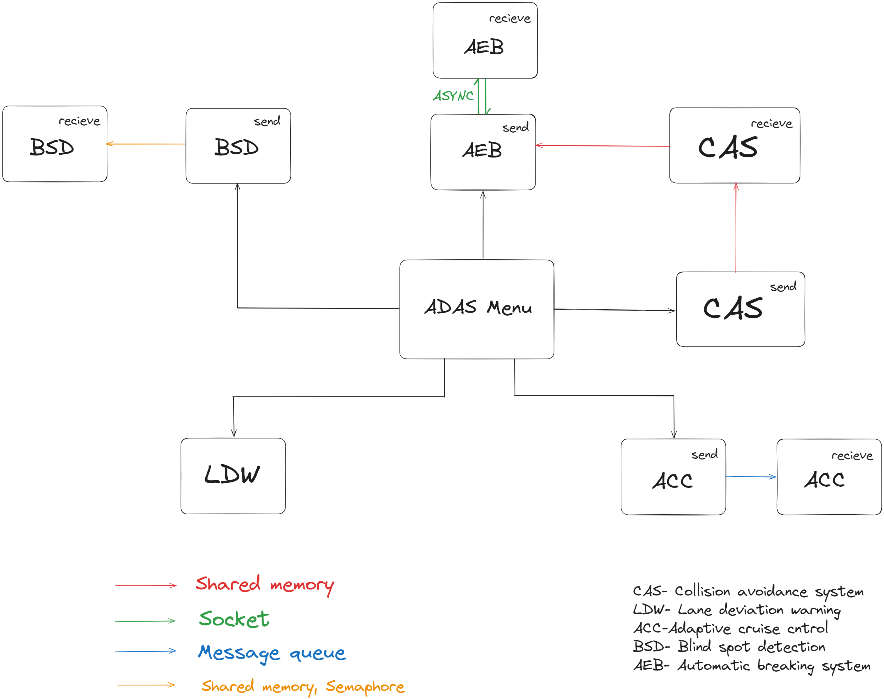
Block Diagram

Slide 6
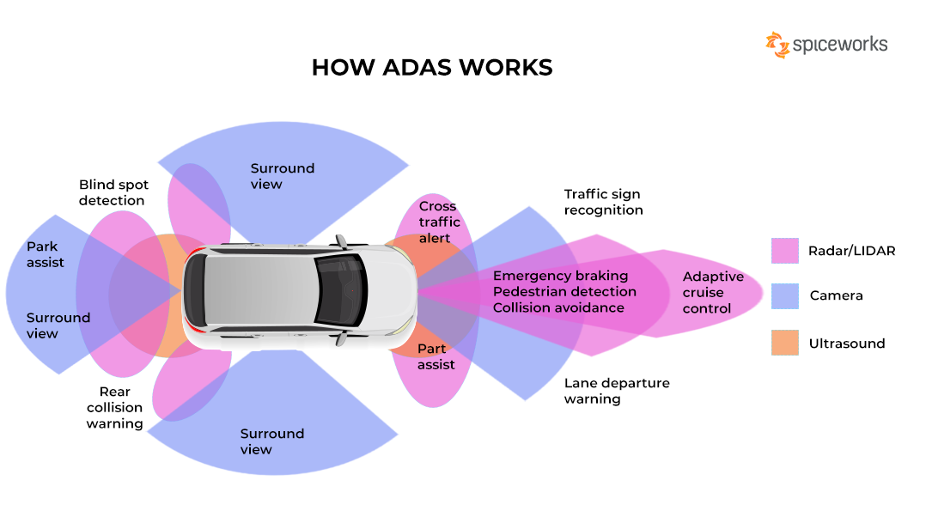

Slide 7
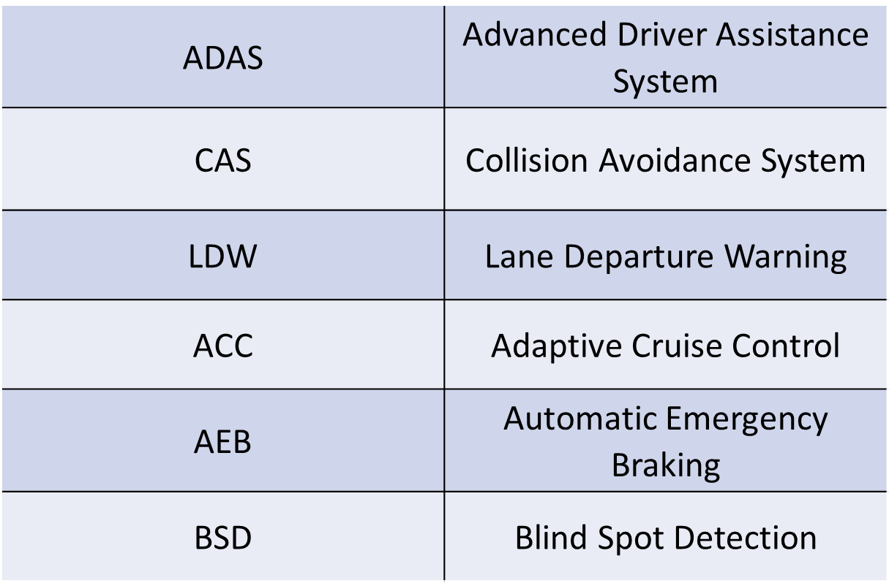
Definitions, Acronyms, and Abbreviations

Slide 8
Collision Avoidance System (CAS)
A collision avoidance system (CAS), also known as a pre-crash system, forward collision warning system (FCW), or collision mitigation system, is an advance driving assistance system designed to prevent or reduce the severity of a collision.
In its basic form, a forward collision warning system monitors a vehicle's speed, the speed of the vehicle in front of it, and the distance between the vehicles, so that it can provide a warning to the driver if the vehicles get too close, potentially helping to avoid a crash.

Slide 9
Implementation
For CAS, the program will ask the user about whether there are any cars or other objects in the vicinity and if so, their distance from the car. If they are closer than a pre-specified maximum distance, the program classified the event as a collision and then calls the AEB module for stopping the car immediately and deploy the airbags if possible.
Here we used Shared Memory to communicate whether there is a chance of collision and then send that result to the AEB module.

Slide 10
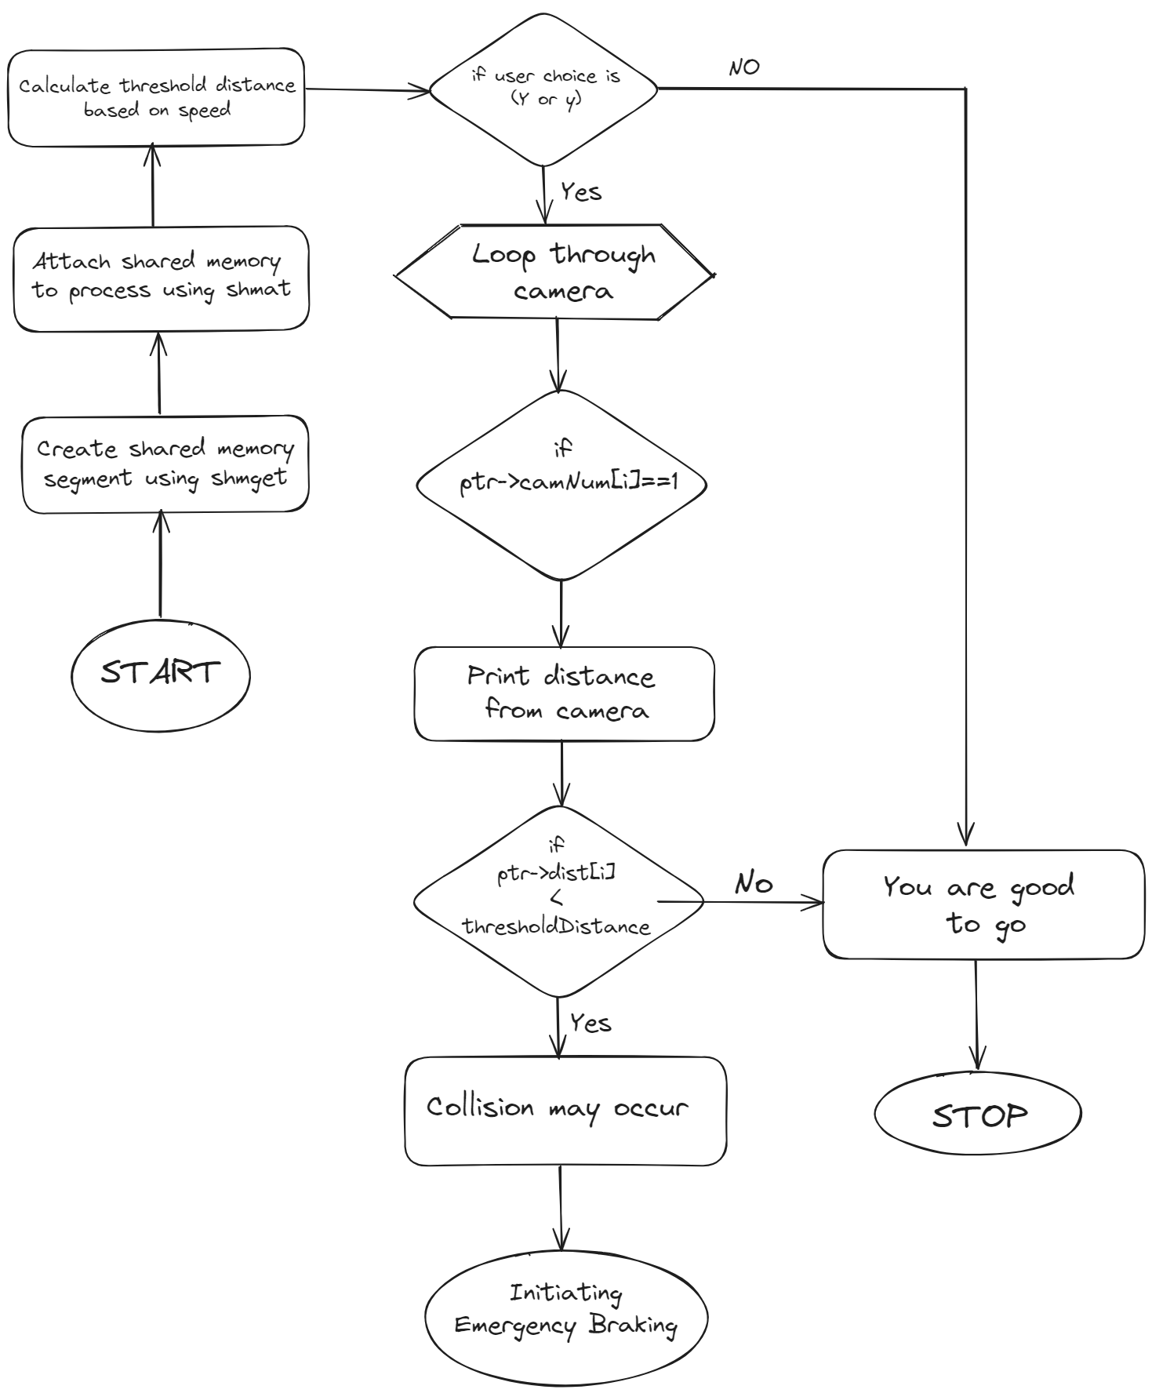
Flowchart

Slide 11
Lane Departure Warning (LDW)
In road-transport terminology, a lane departure warning system (LDWS) is a mechanism designed to warn the driver when the vehicle begins to move out of its lane (unless turn signal is on in that direction) on freeways and arterial roads.
These systems are designed to minimize accidents by addressing the main causes of collisions: driver error, distractions and drowsiness.

Slide 12
Implementation
For LDW, program asks the user whether the car is still cruising in the lane or not. If it is not, it means that the car has deviated from the lane and if that is the case, it will immediately alert the driver regarding it.
We have detected the user input using a signal interrupt and then used a signal handler function to alert the driver on the console according to whether the car is deviating from the lane
After Alerting the driver on console, it will prompt the driver again to make sure if he wants to change the lane, if not we'll call the ACC module.

Slide 13
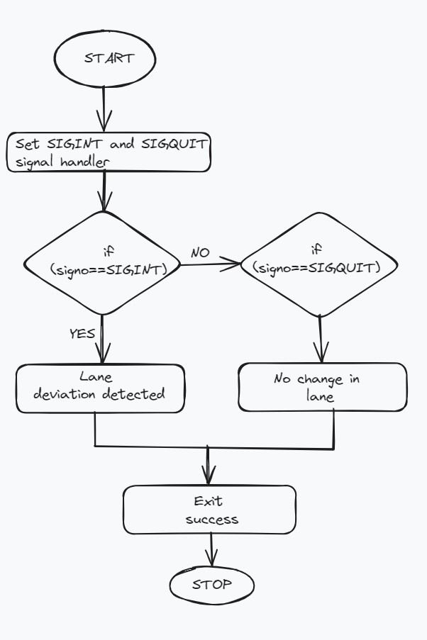
Flowchart

Slide 14
Adaptive Cruise Control
Adaptive cruise control (ACC) is an enhancement of conventional cruise control. ACC automatically adjusts the speed of your car to match the speed of the car in front of you. If the car ahead slows down, ACC can automatically match it.
Once the car ahead moves out of your lane or accelerates beyond your car’s set speed, your ACC allows your car to return to the speed that you have set. Other than setting your speed, you only need to turn on the system and select your preferred following distance.

Slide 15
Implementation
For ACC, we will enter our current speed and the distance separating our car from the car in the front. If the cars are too close (i.e., distance < maximum threshold distance), we changed the speed of the car to some value such that the distance gets increased to at least the threshold value.
We used Message Queue to access the structure containing the attributes of the car including the speed and change it there.

Slide 16
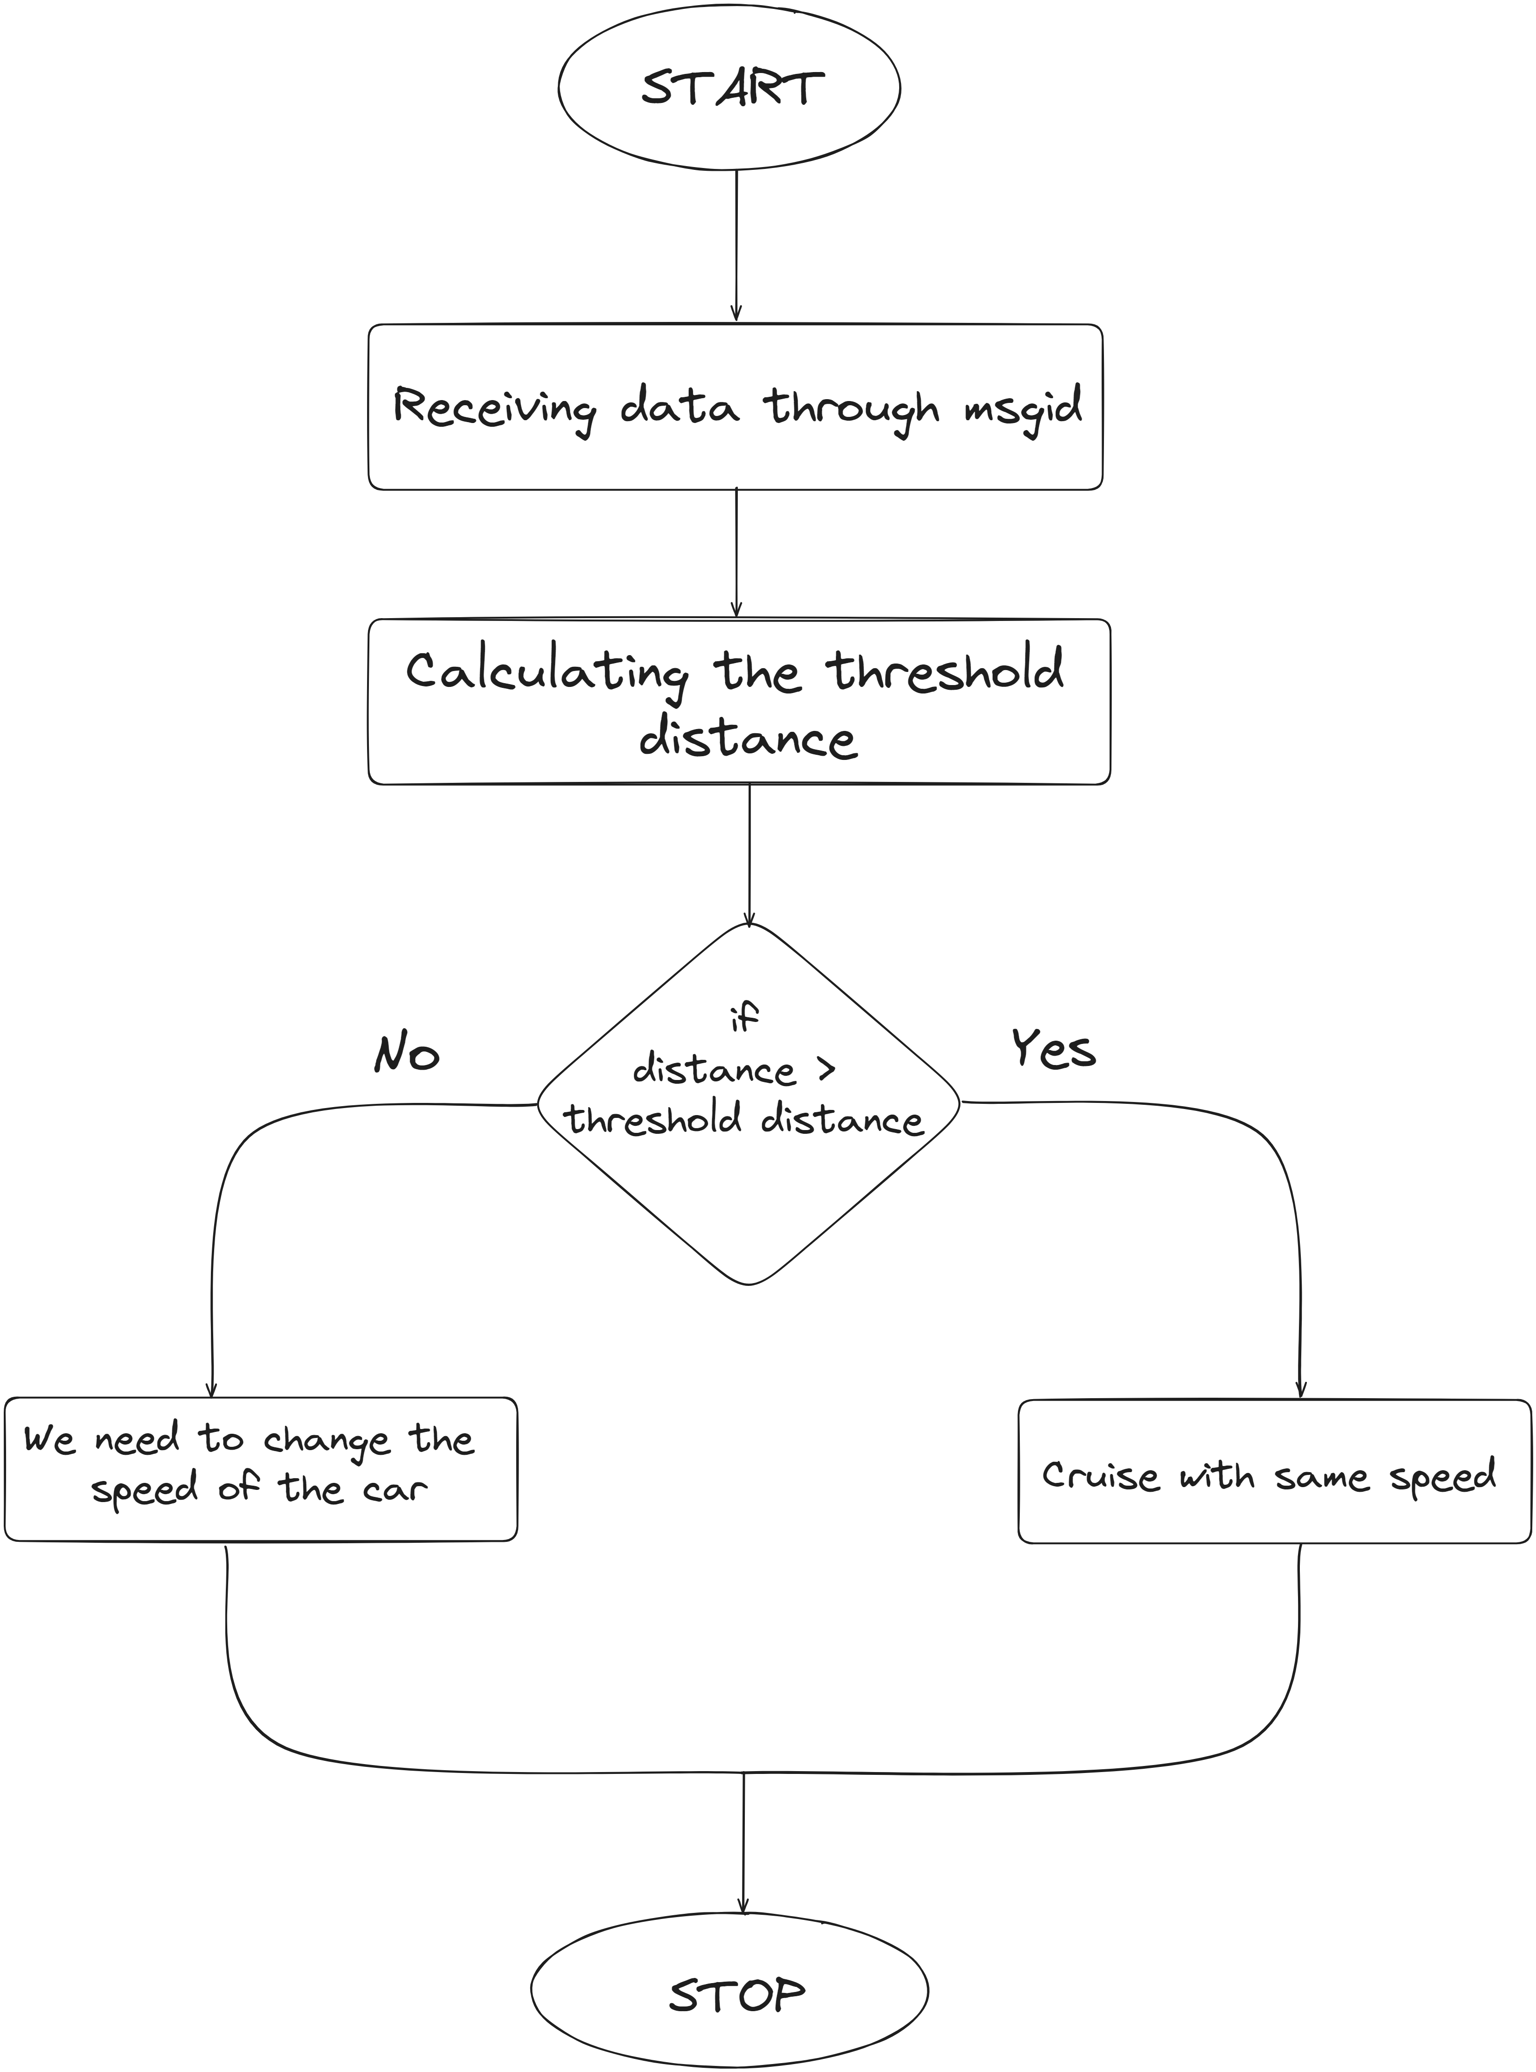
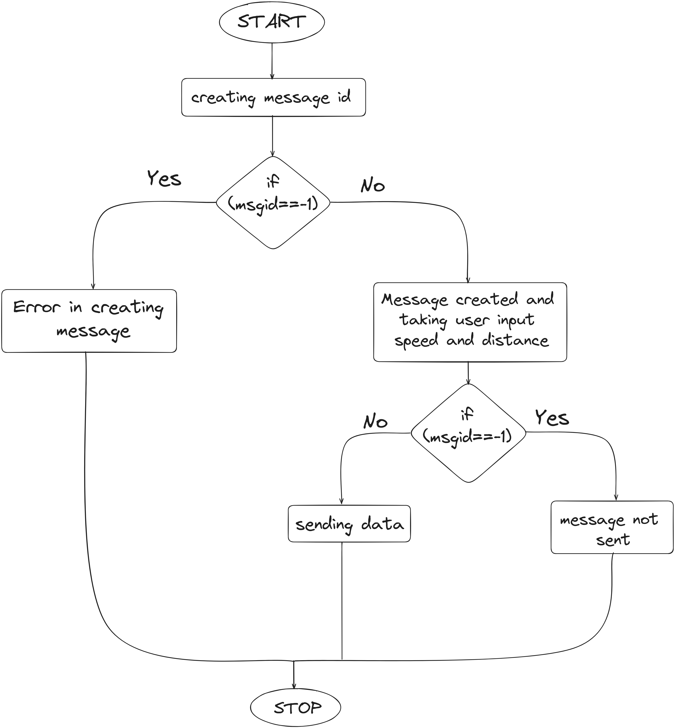
Flowchart

Slide 17
Automatic Emergency Braking (AEB)
Automatic emergency braking (AEB) is a safety system that can identify when a possible collision is about to occur and responds by autonomously activating the brakes to slow a vehicle prior to impact or bring it to a stop to avoid a collision.
It has quickly become one of the most essential safety systems in our cars. It’s so vital that an agreement between American automakers and the National Highway Traffic Safety Administration (NHTSA) will see all new vehicles sold in the US equipped with AEB as standard equipment by September 1, 2022.

Slide 18
Implementation
In emergency braking system (AEB), We are accessing the structure containing the different attributes of a car using shared memory in the server and changing the speed by sending this speed to the client using Sockets
We totally stopped the car in a gradual way so that the car does not skid so we will use the delay() function to decrease the speed of the car after some set time interval each time until it becomes zero.

Slide 19
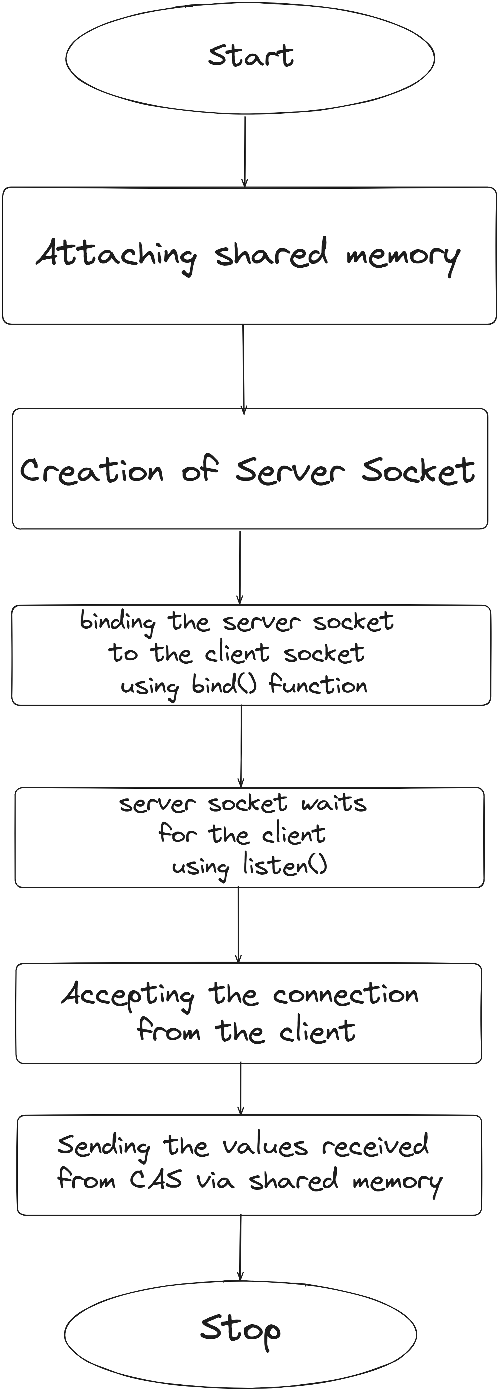
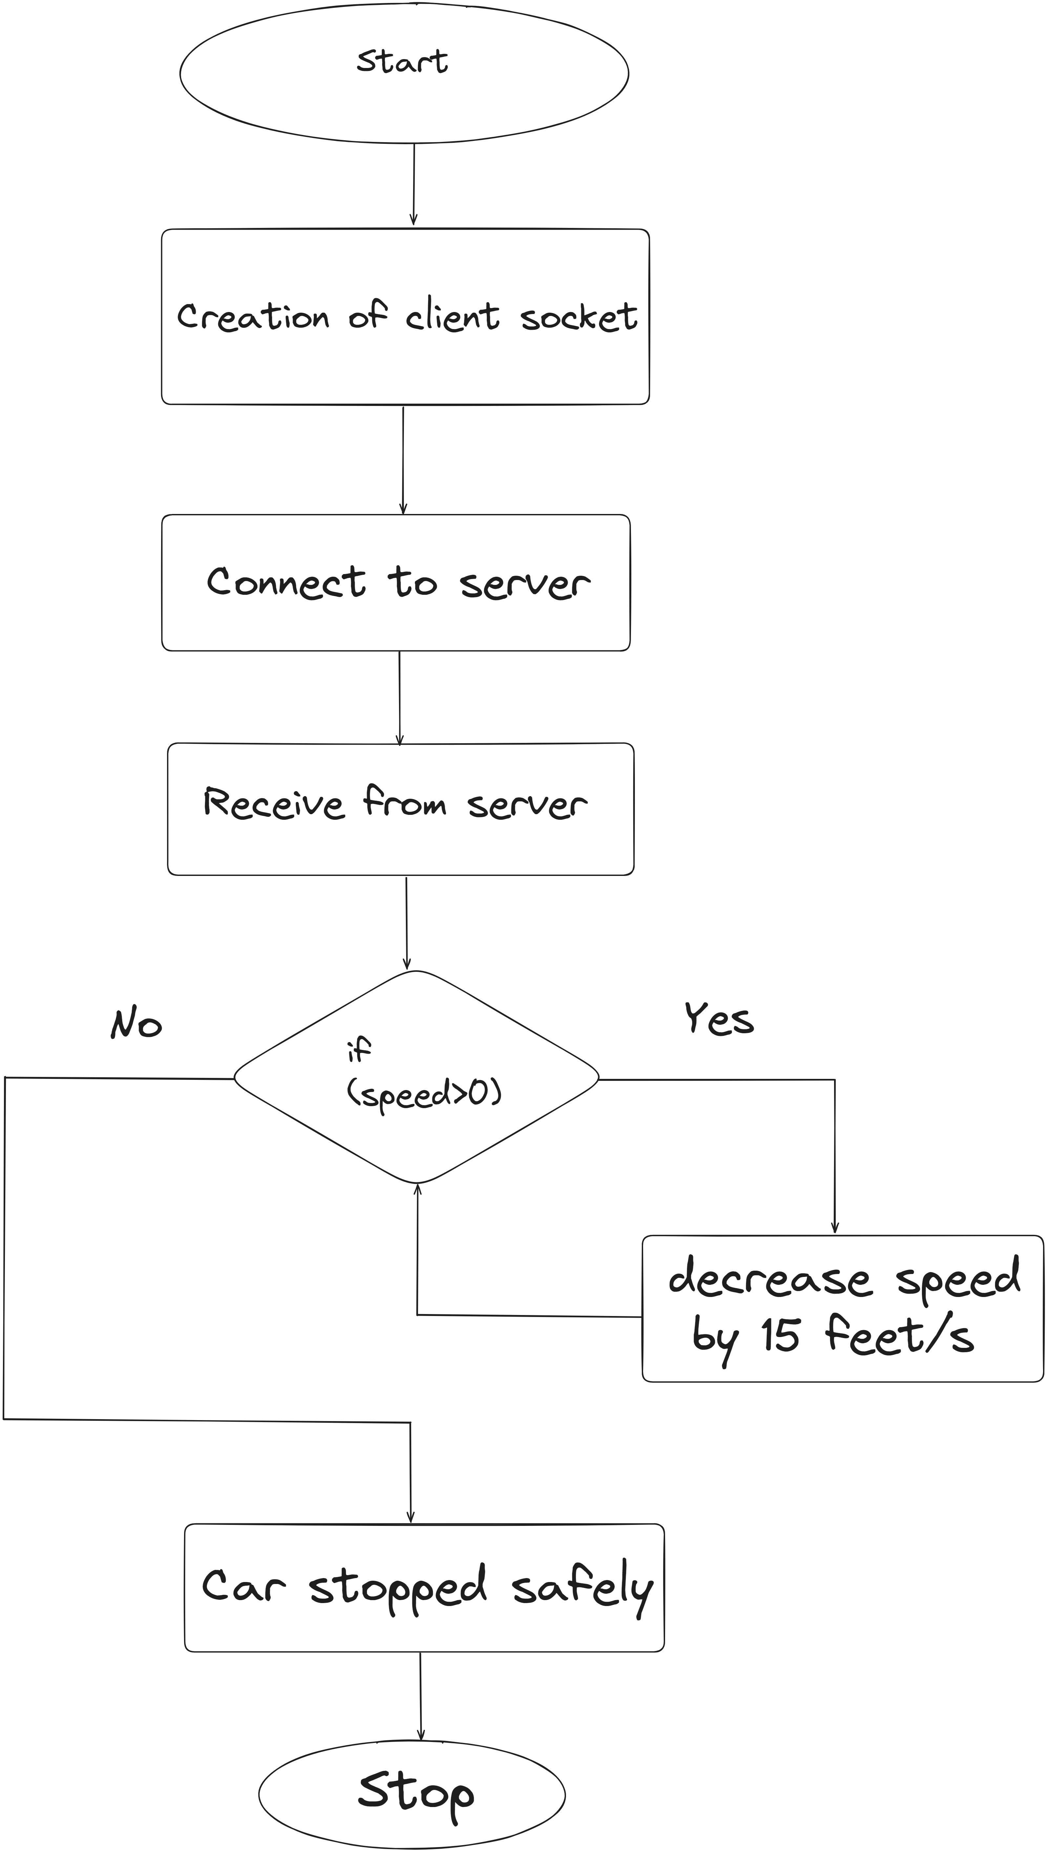
Flowchart

Slide 20
Blind Spot Detection (BSD):
Blind spot detection is an advanced driver assistance system (ADAS) feature that uses cameras to detect vehicles or objects in a driver's blind spot.
The blind spot is the area on the side of the car that the driver can not see when looking in the rearview mirror or side-view mirror.

Slide 21
Implementation
In blind spot detection (BSD), The program asks the user whether there are any blind spots in their vicinity. If there are, it will call the alert function to warn them.
We used shared memory to send a flag according to whether there is any blind spot and if there is, the alert function will be called.
Here, there are different threads for the different cameras in the blind spots of a car and at a time only a single thread will be able to access the alert function which will be made as the critical zone, and we use semaphores to ensure that at a time only one thread will be accessing it (i.e., mutual exclusion)

Slide 22
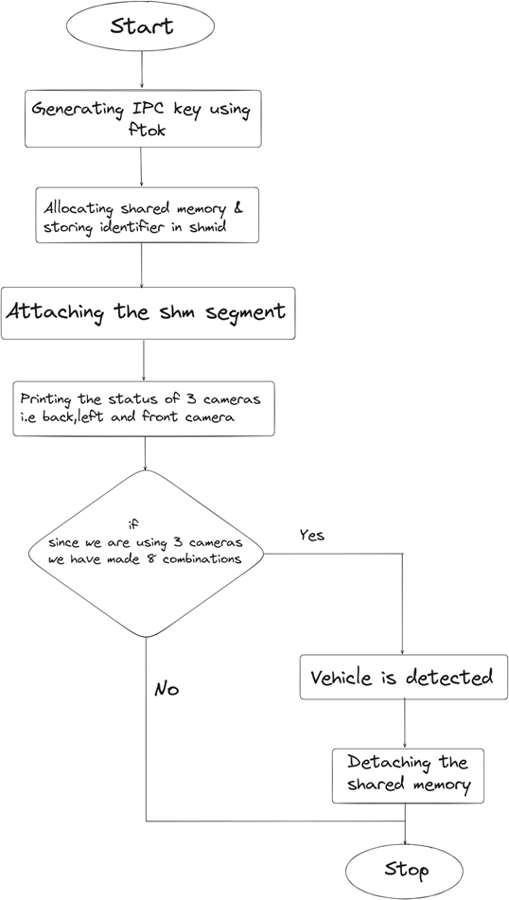
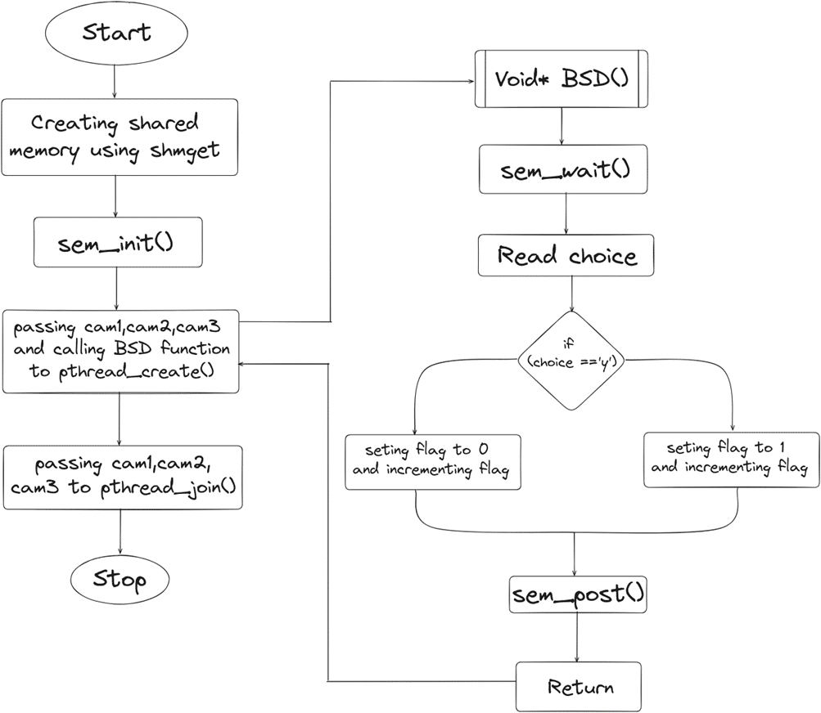
Flowchart

Slide 23
Conclusion
In conclusion, while building this Advanced Driver Assistance System, me and my teammates learnt how to implement system calls and work with complex C programs having many different features in large-scale projects with many different modules and files interacting with each other.

